Slide 1
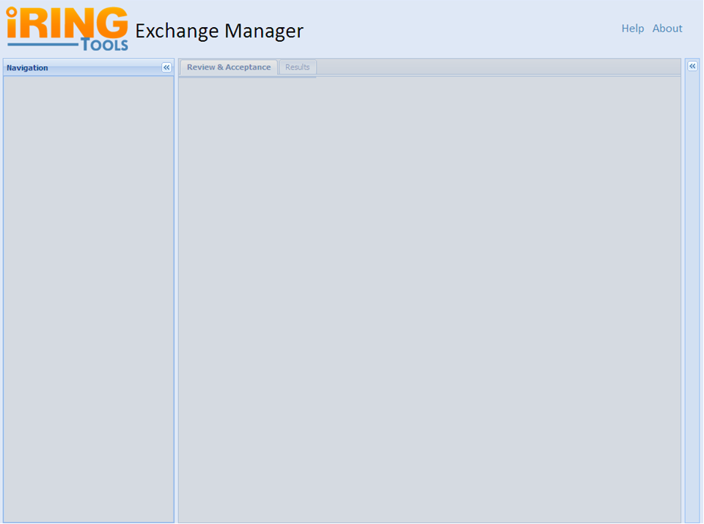
IRINGTOOLS-8: Basic Layout
Notes:
Sub Tasks:
Package ExchangeManager for Deployment.
Deploy ExchangeManager Package and Verify on Test Server.

Slide 2

IRINGTOOLS-1: About Screen
Version #
Exchange Manager Short Description
  What is Exchange Manager
  Mention and Link to WSO₂
  Licensing Information (Link:BSD3)
Link: iRING User Group
This should be more of a mock up of the actual Screen.
Notes:
Links:
WSO2: http://wso2.com/products/enterprise-service-bus/
BSD3: http://www.opensource.org/licenses/bsd-license.php
iRINGUG: http://iringug.org/wiki/index.php?title=ExchangeManager
Help Link will goto: http://iringug.org/wiki/index.php?title=ESBUsersGuide

Slide 3
IRINGTOOLS-6: Directory Resource
ESBServices will temporarily provide a Directory Resource.
Example Base Uri (will be configurable in PHP): http://localhost:8080/iringtools/directoryservice
Relative Uri: /directory
Method: GET
Notes:
Sub Tasks:
Adjust exsiting prototype Directory class per team discussion.
Package ESBServices for Deployment.
Deploy ESBServices Package and Verify on Test Server.
Sample Directory XML:
http://iring-tools.googlecode.com/svn/trunk/iRINGTools.ESB/documents/directory.xml

Slide 4
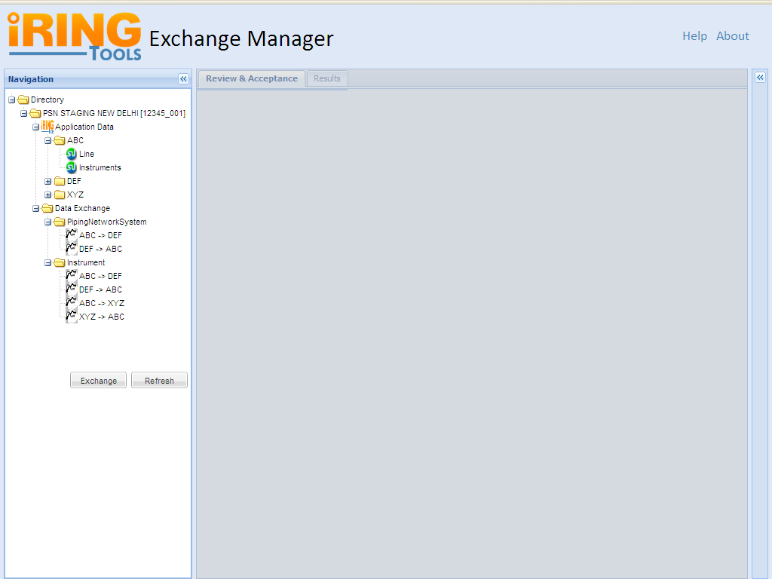
IRINGTOOLS-14: Directory Panel
Default View for a Project
Notes:
Directory Panel
This Panel will show a tree view of all Application Data and Data Exchanges coming under each Project Scope.
Sub Tasks :
1.. Handling the Request and Response of Web Services
2.. Marshaling for XML to JSON conversion
3.. Generate Tree View and display in Navigation Panel
4.. Events Handling
4.1 Display Dialog box on double click on nodes under Data Exchange.
4.2 Click on Exchange Button
4.3 Click on Refresh Button
4.4 Enabling and Disabling panels on different events
5.. Unit Testing
6.. Deploy and Verify on Test Server
Default view of this Page:
- Navigation Panel expanded with Directory Listing Collapsed
- Disabled Center Panel with tabs: Review & Acceptance & Results
- Property Grid Collapsed
Assumptions: Exchange Manager Knows All the Project Scopes & the Navigation Panel is responsible for display of all Applications & their exchanges.
To get the details of these Exchanges we will consume the web service from the PHP Application. After getting the XML Response we will use PHP to generate the View.
Sample Directory XML:
http://iring-tools.googlecode.com/svn/trunk/iRINGTools.ESB/documents/directory.xml

Slide 5
IRINGTOOLS-19: Handling Request and Response of Web Services
Step 1:
Exchange Manager will send restful request to Web Service Provider
URI:
http://ws_provider_url/directoryservice/
Step 4:
Exchange Manager will convert this XML response to appropriate tree view
Exchange Manager
Web Service Provider
Step 3:
Will provide the XML response to Exchange Manger
Client
Step 2:
Will process the request
Notes:
Title Task :
Handling the Request and Response of Web Services
Description :
To get the content like directory.xml we will send ws request with
@path params
N/A
Example: http://localhost:8080/iringtools/directoryservice/exchanges
Method: GET

Slide 6
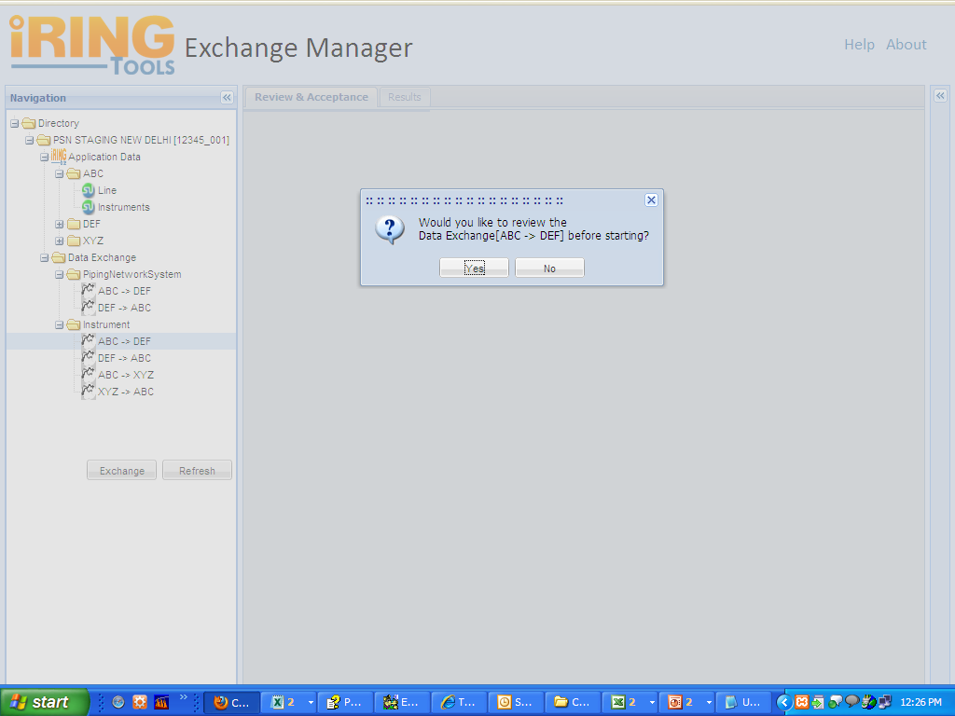
IRINGTOOLS-16: Event Handling
User double clicked on an Exchange Name like ABC >> DEF
User Clicked on Yes
Notes:
Task Title : Event Handling
Sub Tasks:
- Display Dialog box on double click on nodes under Data Exchange.
- Click on Exchange Button
- Click on Refresh Button
- Enabling and Disabling panels on different events
Functionalities of Dialog Box:
- Ask for Review before Exchange with options Yes/No
- In case of "Yes" : Under Review & Acceptance Tab Tree and Grid will be generated
- In case of "No" : Data will transfer from the Source >> Destination application directly and display the Status Under Result Tab

Slide 7
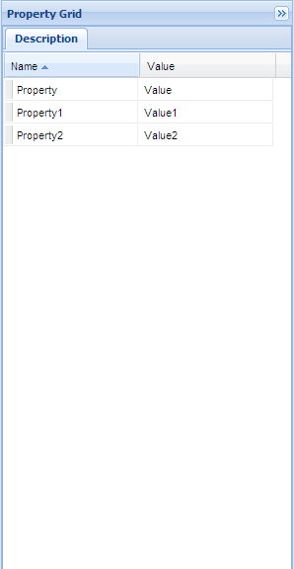
IRINGTOOLS-15: Property Grid
As soon as clicked on exchange the grid will updated
User Clicks on an Exchange
Notes:
Property Grid Panel
This Grid Panel will populated with corresponding data as soon as a user clicks on the exchange name on Navigation Panel.
The Directory.xml will be used to get the details(Property & Value) of each node.
Sub Tasks :
1. Binding with Directory Tree
2. Marshaling for XML to JSON conversion
3. Generate Grid View

Slide 8
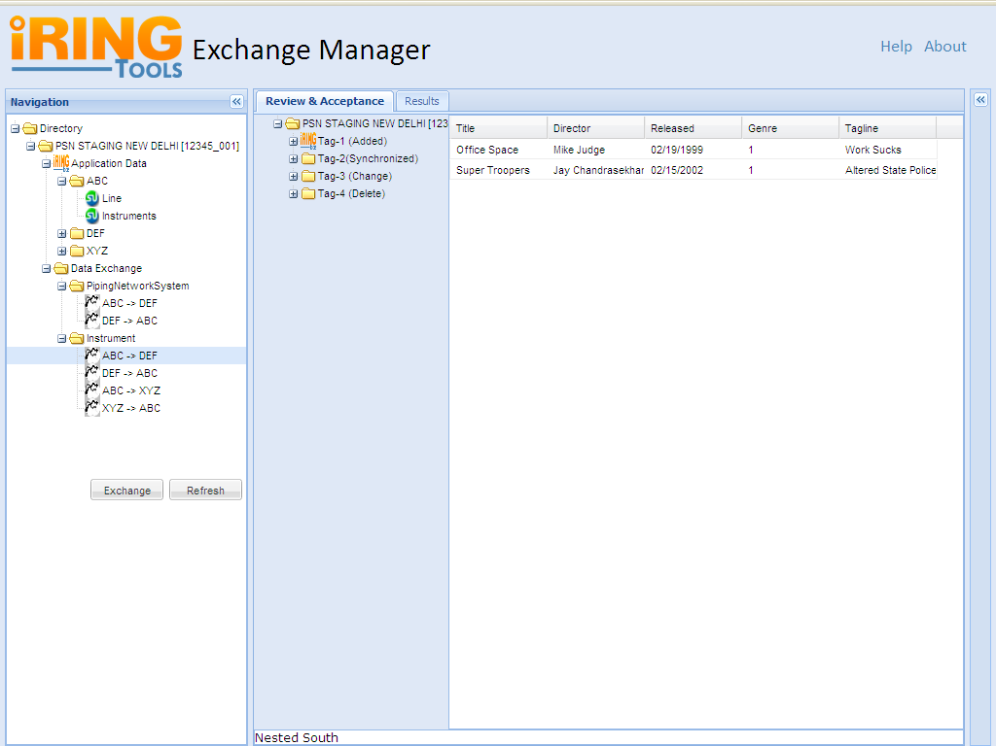
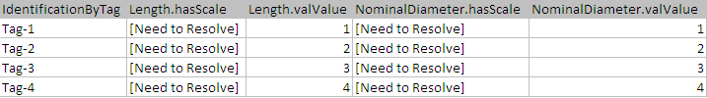
IRINGTOOLS-17: Review & Acceptance Panel
Notes:
Review & Acceptance Pane
This Panel will show a tree view of all identifiers, properties and values of a selected Data Exchange. Identifiers will be displayed in Tree View and their properties/values in Grid View form.
Sub Tasks:
- Handling web services Request & Response for DTI as well as DXO
- For Tree Marshaling XML to JSON conversion
- Display Tree Panel of Identifiers
- Pagination on Tree Panel
- Marshaling XML to JSON conversion for Grid View
- Display Grid View of properties and their values
- Binding Tree with the Grid View
- Implement caching mechanism
- Transfer or send data to destination application
- Unit Testing
- Deploy and Verify on test server
Default view of this Page:
- Navigation Panel expanded
- Expanded Review & Acceptance Tree Panel along with 1st 20 identifiers list
- Paging at the bottom of Tree
- Expanded Review & Acceptance Grid Panel along with the list of properties of first tag
- Property Grid Collapsed
Assumptions: Exchange Manager Knows the exchangeID whose DTI info to be fetched from the web service.
First the Web Service will respond the DTI info and our Exchange Manager App will convert into appropriate format so that it can send another Web service request to get the DTO information of these set of identifiers. We have all information related to the 1st set of identifiers with us and we will able to generate the Tree & Pagination.

Slide 9
User Clicked on Yes
Step-5
Will generate the Tree & Pagination with default grid view for Review & Acceptance tab
Client
Exchange Manager
Step-1
Request for DXI Info with exchangeID
Step-3
Will send request for DXO information for the 1st 20 identifiers
Step-4
Will return XML response for DXO related to those identifiers
Step-2
Will return the XML response for DXI related to that exchangeID
Web Service Provider

Slide 10
DTI Request
To get the content like dti.xml we will send ws request with
@path params: exhangeID
Example Base Uri (will be configurable): http://localhost:8080/iringtools/diffservice
Relative Uri: /{scope}/exchanges/{exchangeid}/index
Method: GET

Slide 11
DTO Request
To get the content like dto.xml we will send ws-request with
@path params:exchangeID
@request params: dti (subset or entire dti from request #2)
Example: http://localhost:8080/iringtools/diffservice
/{scope}/exchanges/{exchangeID}
Method: POST

Slide 12
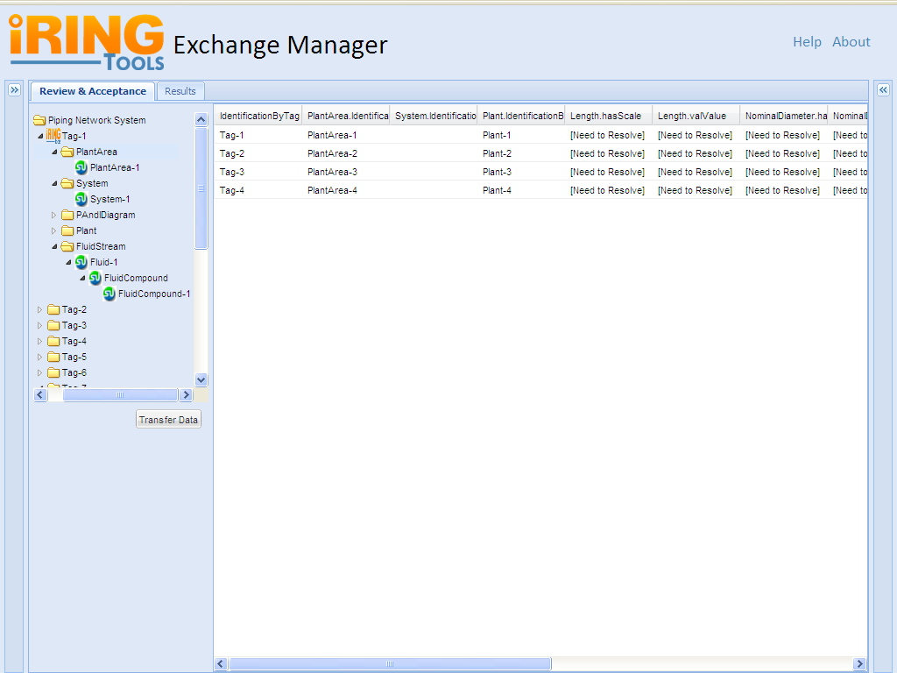
IRINGTOOLS-18 : Tree Generation
As soon as the user will select the nodes the corresponding property for that node will be populated within a grid view
Notes:
Default view:
- Review & Acceptance Tree Listing would be in form of expanded as first level
(Display only Identifier Tags i.e. Tag-1, Tag-2)
- Paging on the bottom of the Tree.
Functionality :
- Display Tree with the combination of DTO and DTI
- A User can traverse the tree to know about properties or values associated with each identifier.
- On Click a Identifier node can be expand upto three level.
- The Grid View would be populated on click of any Tree Node.

Slide 13
As soon as the user will select the nodes the corresponding property for that node will be populated within a grid view
User wants to Transfer the Data after Review & Acceptance

Slide 14
Exchange Submittal
To submit dxo to adapter service
@path params:scope, exchangeId
@request params:dto
Example: http://localhost:8080/iringtools/diffservice
/{scope}/exchanges/{exchangeId}
Method: POST

Slide 15

Results Tab

